Slide 1
FoodFinder COVID-19 Relief Overview
Prepared by
Jack Griffin - Founder & CEO
UPDATED – 11/25/20

Slide 2
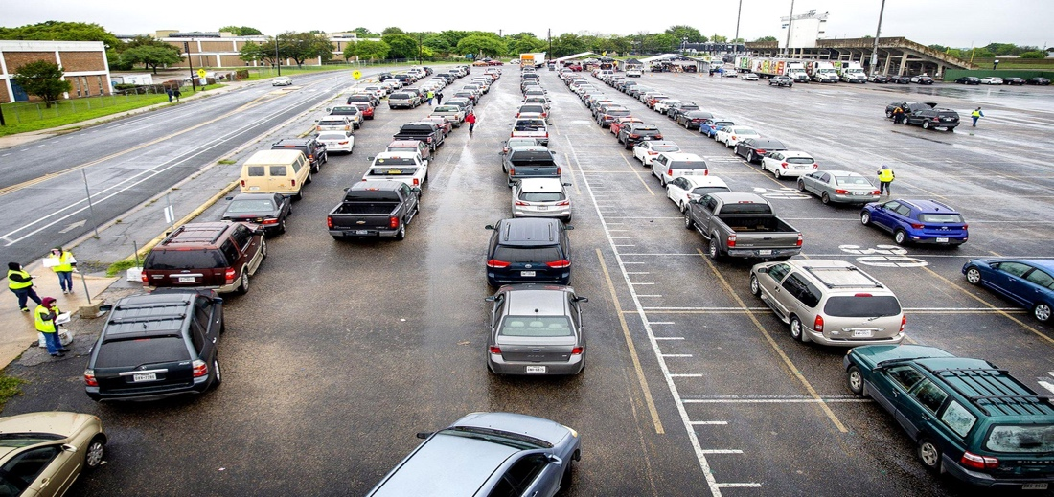
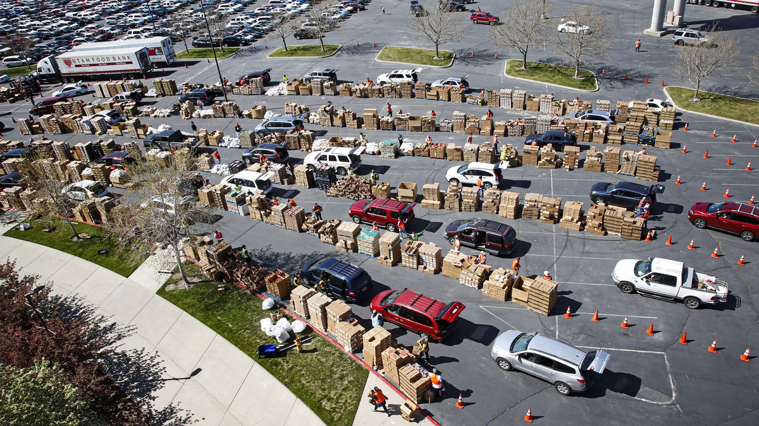
COVID-19 and Hunger in America
50,000,000+
Americans now face food insecurity
(Feeding America)
1 out of 4
children in America now face food insecurity
(No Kid Hungry)

Slide 3
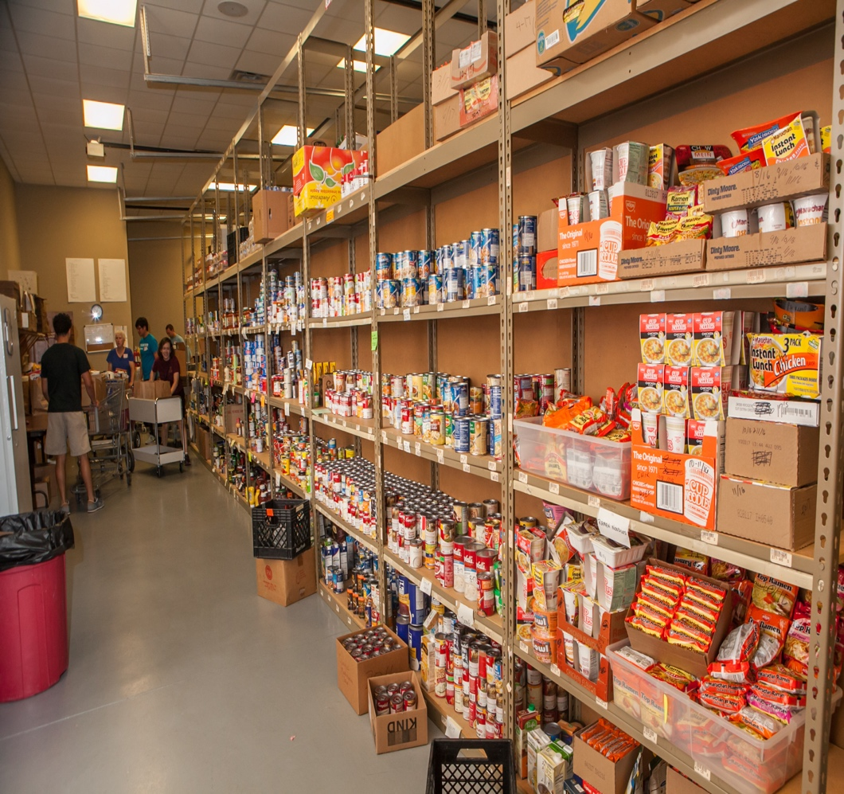
The Problem in Seeking Help
Even pre-COVID, Google searches from people looking for food pantries between 2015 and 2019 increased by
863%
(Google Keyword Planner)
The problem? Those searches still present confusing, often contradictory information.

Slide 4
FoodFinder Intro
What is FoodFinder?
a 501(c)(3) nonprofit
a website – foodfinder.us
a mobile app – iOS + Android

Slide 5
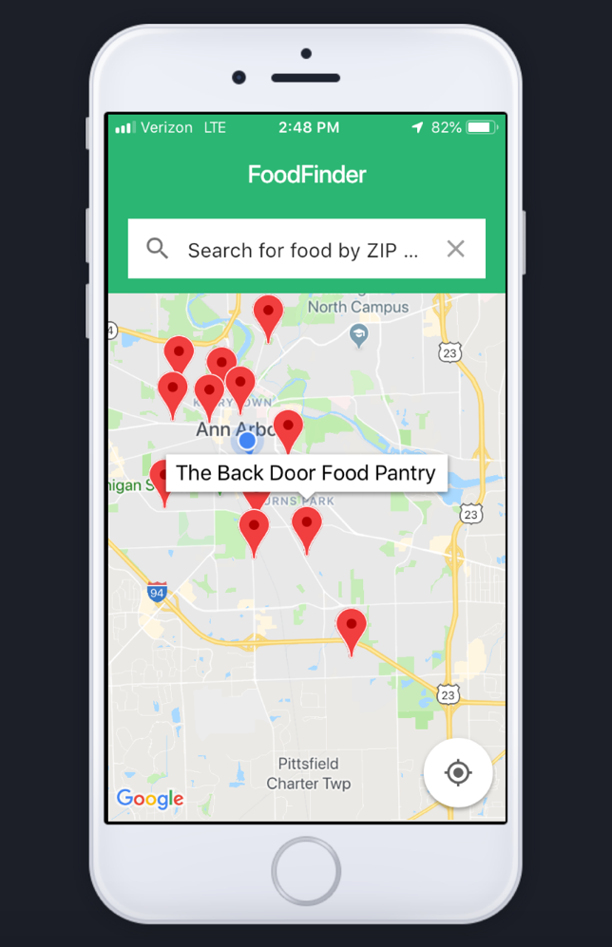
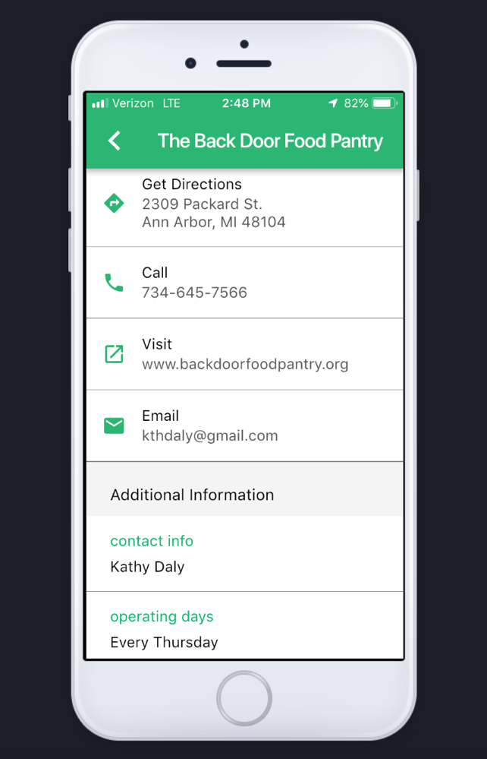
Our Platform
Our platform is nationwide with information on 46,000 food pantries and 10,000’s more school meal locations
What sets us apart:
Quality of data
Quantity of data
Our partner network

Slide 6
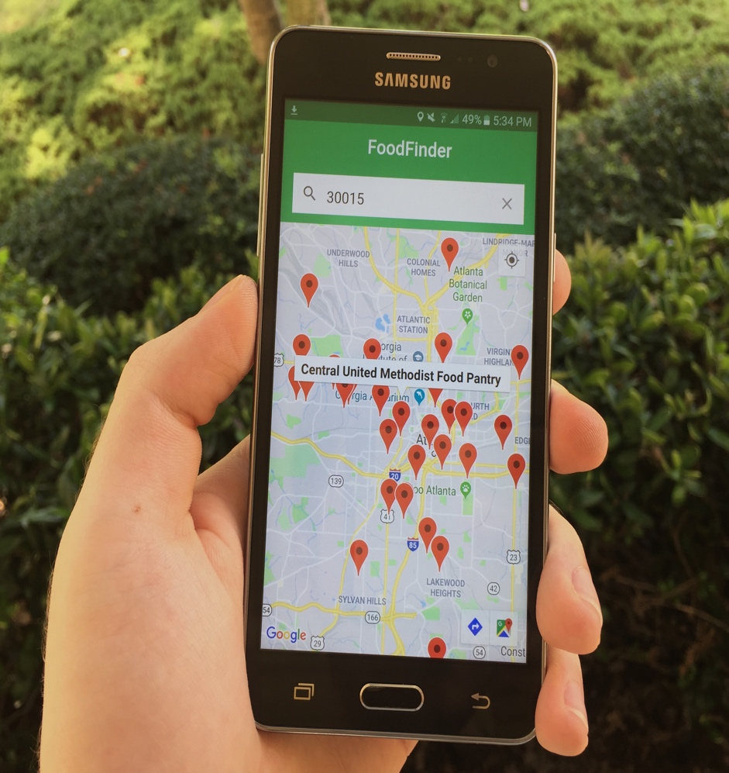
Our Financial Sustainability Model
The FoodFinder API helps other hunger relief organizations better fulfill their missions while earning revenue to pay for our mission
This B2B technology gives clients:
a custom co-developed version of our food pantry locator and/or
a direct link to our food provider database (a monthly subscription)

Slide 7
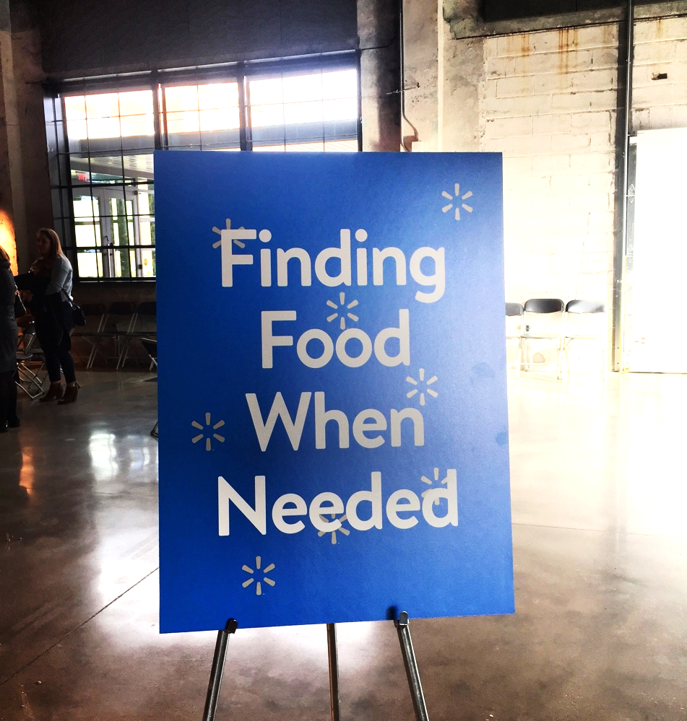
Product-Market Fit
In less than a year, we found strong product-market fit and a true win-win scenario for us and our partners.
4 API Partners
$399k in
Revenue

Slide 8
Traction
API Partners
Funding Partners
Media Features

Slide 9
We’re in Good Company
FoodFinder is only six years old with a
$500k budget, but we’ve joined the biggest names in hunger relief on nationwide initiatives.

Slide 10
Our Impact
Growth in People Served
Impact by the Numbers
3x
growth in annual impact since 2017
220,000
275,000 people
127,000
connected to food during the pandemic
425,000 people
32,000
10,000
2017
2018
2019
1st Half of 2020
served since launch

Slide 11
Our Goals for 2021
1
Connect at least one million Americans impacted by COVID-19 to food assistance
2
Secure at least nine more data-sharing API partners who also address COVID-related hunger
3
Surpass 50,000 full-time food pantries in our database and on our assistance map

Slide 12
Thank You
jack@foodfinder.us
770-846-3367

